Slide 1


Slide 2
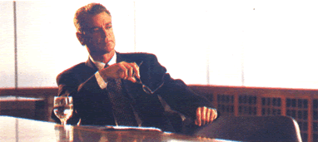
He is a businessman.
He lives in New York.

Slide 3
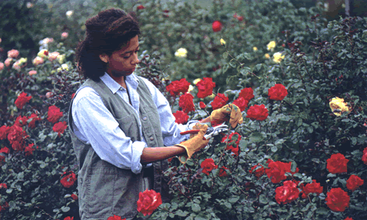
Olivia likes red roses.
Does she work ?
No, she doesn’t.

Slide 4
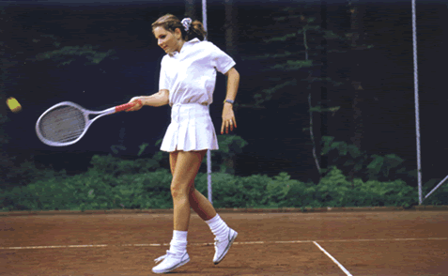
The present simple is used for:
repeated actions or daily routines
Does she like tennis?
Yes, she likes tennis.
She plays tennis in the afternoons.

Slide 5
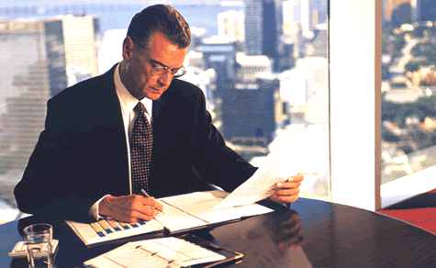
Does he work ?
Yes, he does. He works in an office.

Slide 6
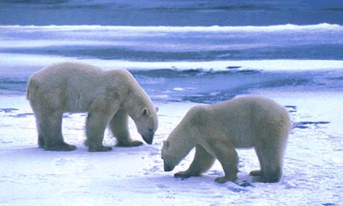
Polar bears don’t live in hot places.
They live in the North Pole.
Do they eat fruit and vegetables?
No, they don’t. They eat fish.

Slide 7
positive
I
play
basketball.
You
play
basketball.
He
play
s
basketball.
She
play
s
basketball.
It
play
s
basketball.
We
play
basketball.
You
play
basketball.
They
play
basketball.

Slide 8
negative
I
don’t
wash
the car.
You
don’t
wash
the car.
He
doesn’t
wash
the car.
She
doesn’t
wash
the car.
It
doesn’t
wash
the car.
We
don’t
wash
the car.
You
don’t
wash
the car.
They
don’t
wash
the car.

Slide 9
question
Do
I
go to the cinema?
Do
you
go to the cinema?
Does
he
go to the cinema?
Does
she
go to the cinema?
Does
it
go to the cinema?
Do
we
go to the cinema?
Do
you
go to the cinema?
Do
they
go to the cinema?

Slide 10
(+)
You
play
soccer
in the afternoon
(-)
don’t

Slide 11
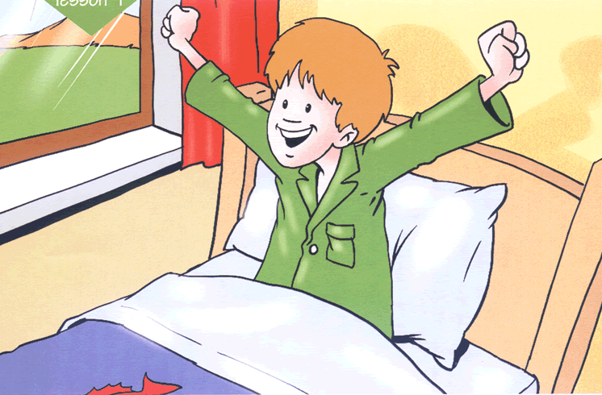
wake up

Slide 12
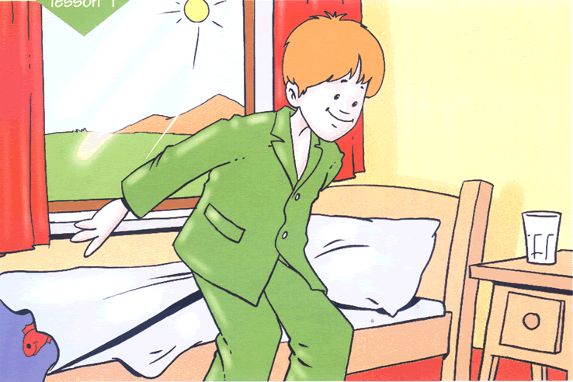
get up

Slide 13
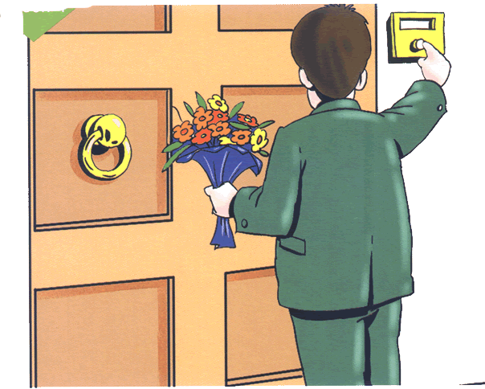
visit

Slide 14
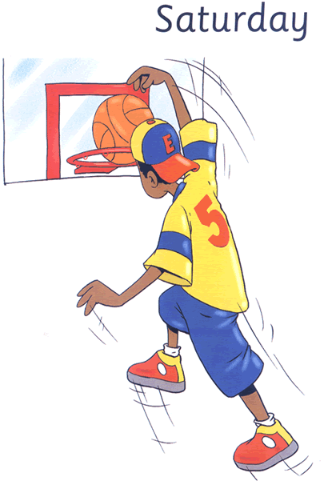
He plays basketball in the afternoons.

Slide 15
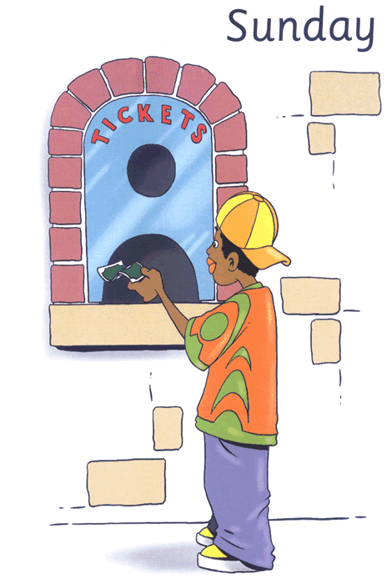
He goes to the cinema .

Slide 16
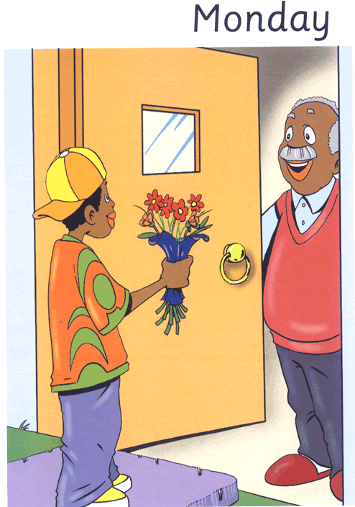
He visits his grandfather in
the morning.

Slide 17
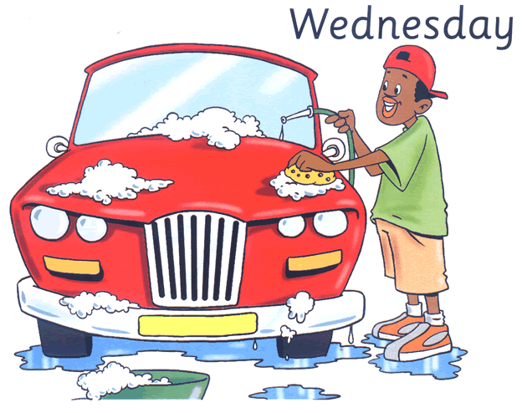
He washes the car in the afternoons.

Slide 18
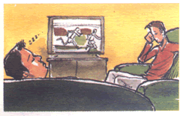
they / like athletics
Do they like athletics?
No, they don’t.

Slide 19
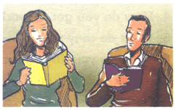
you and your husband / read books
Do you and your husband read books?
Yes, we do.

Slide 20
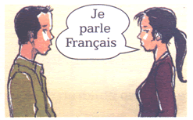
you / speak French
Do you speak French?
Yes, I do.

Slide 21
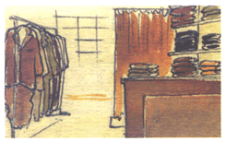
they / sell cell phones
Do they sell cell phones?
No, they don’t.

Slide 22
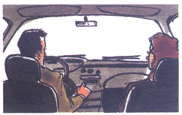
they / drive to work
Do they drive to work?
Yes, they do.

Slide 23
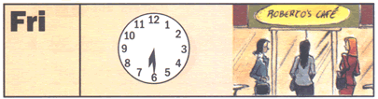
Where does she go on Fridays?
She goes to Roberto’s cafe.

Slide 24
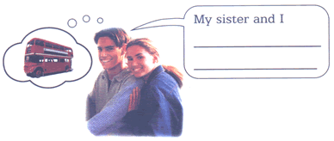
How do you get to school?
take the bus
to school.

Slide 25
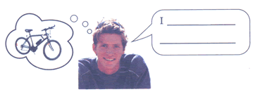
How do you get to school?
ride my bike
to school

Slide 26
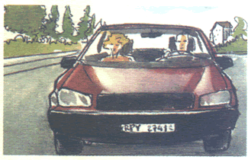
How / get work
How do they get to work?
They drive.

Slide 27
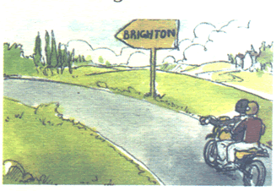
Where / live
Where do they live?
They live in Brighton.

Slide 28
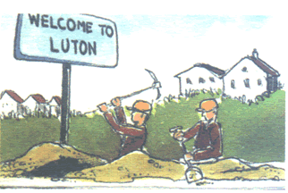
Where / work
Where do they work?
They work in Luton.

Slide 29
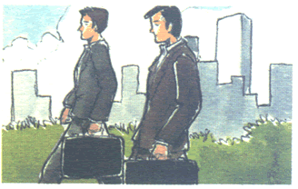
How / get to work
How do they get to work?
They walk.

